Slide 1

ECON3510 – Tutorial 1
Nicholas Umashev

Slide 2
Cool Stuff
https://blueshift.io/international-trade.html
https://www.shipmap.org/
https://planefinder.net/

Slide 3
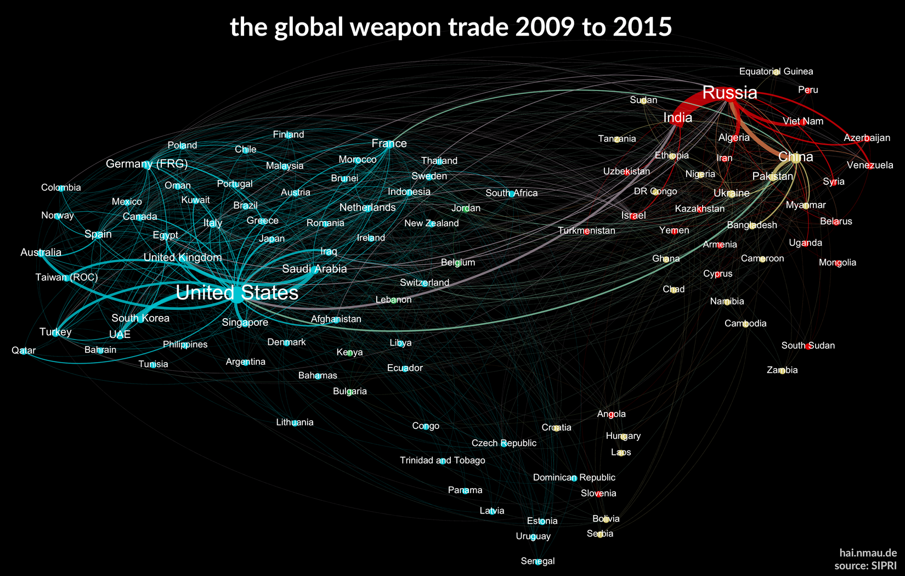
Cool Stuff
Notes:
For example, if China only contributed $6 to making the $400 iPhone then the total $400 contributes to its exports figure

Slide 4
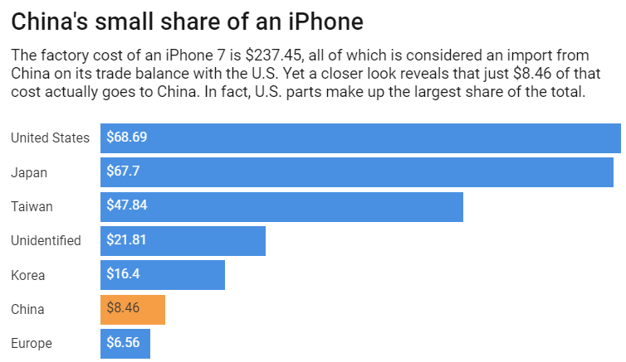
Recap: What is Counted as Exports and Imports
Exports: the total value of the good exported, it is not the value added by the country.
Imports: the total value of the good imported, it is not the value added of the exporting country
Exports – Imports: the difference between exports and imports is equal to the nations value added
Notes:
For example, if China only contributed $6 to making the $400 iPhone then the total $400 contributes to its exports figure

Slide 5
Question 1 What Can We Infer About Countries Based on Trade

Slide 6
Exercise One
To measure the importance of trade to a country, we take the ratio of that country’s trade (i.e., value of exports plus value of imports) to GDP. Multiplying by 100 gives the percentage of trade to GDP. If a country is running a trade balance, the value of exports is approximately equal to the value of imports. Hence one could also use exports as percentage of GDP, or imports as percentage of GDP.
The World Bank publishes statistics about Exports and Imports as percentage of GDP: https://data.worldbank.org/indicator
Question
Compare the statistics of (at least one of) the following pairs of countries: 1) Australia and Vanuatu; 2) China and Vietnam; 3) USA and Mexico.
Discuss what might explain the differences between the countries in each pair.
Notes:
Discussion time

Slide 7
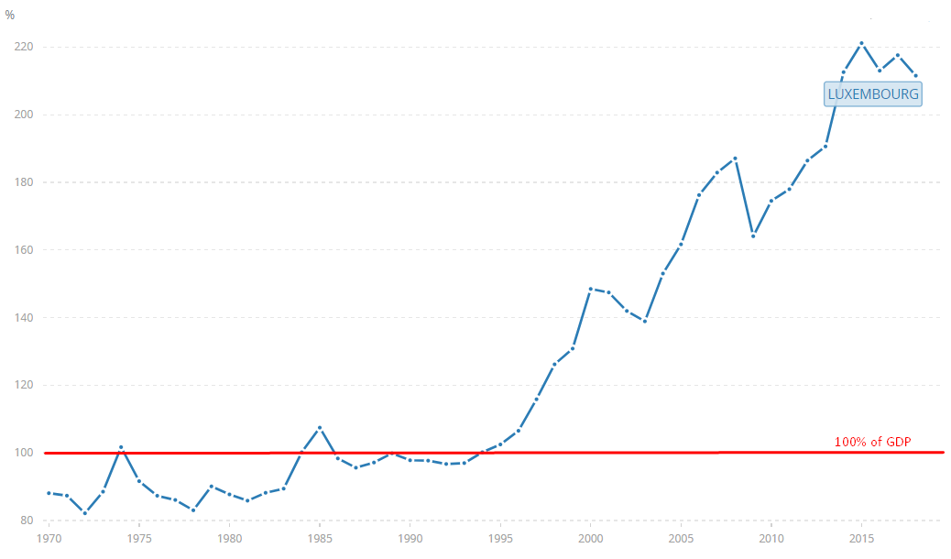
Example: Oddities Concerning Exports as a % of GDP
Luxembourg’s exports as a percentage of GDP were 211.6% in 2018, how is this possible and why?
Notes:
Discussion time

Slide 8
Example Explained
GDP is made up of C + I + G + X – M
Luxembourg is a small country with only 602,000 people. So its consumption, investment, and government spending are relatively low. C + I + G are Low!
Luxembourg produces 2.2 million tons of crude steel per year. That is equal to 3655 kilos of crude steel per person per year. The average person in Luxembourg doesn’t use 3655 kilos of crude steel each year, so obviously they export it. X Goes UP!
Now Obviously you cannot make crude steel out of thin air, so Luxembourg imports iron and other raw materials to make it. Luxembourg is not rich is natural resources, so that is a lot of imports. M Goes UP!
M increasing and X increasing, holding C+I+G constant, means that exports will be greater than GDP
Notes:
Does this make sense or should I draw up an example? C+I+G = 3b, X = 5b, M = 4b. Therefore C+I+G+X-M = 4b while X=5b

Slide 9
Example Continued
Back to our Equations:
C + I + G + X – M < X
C + I + G – M < 0
C + I + G < M Luxembourg is consuming less than it is producing!
Back to our Definitions:
Since Luxembourg’s exports as a percentage of GDP is greater than it’s imports and over 100%, this means that Luxembourg’s value added for trade (X-M) is greater than its domestic production (C+I+G)
What can we Infer about Luxembourg:
It is a country with low consumption and government spending, so it has a small population (C+ I+G)
It exports more than their economy consumes (+X)
Exports are greater than GDP so it must be importing a lot of raw goods (-M)
Notes:
Discussion time

Slide 10
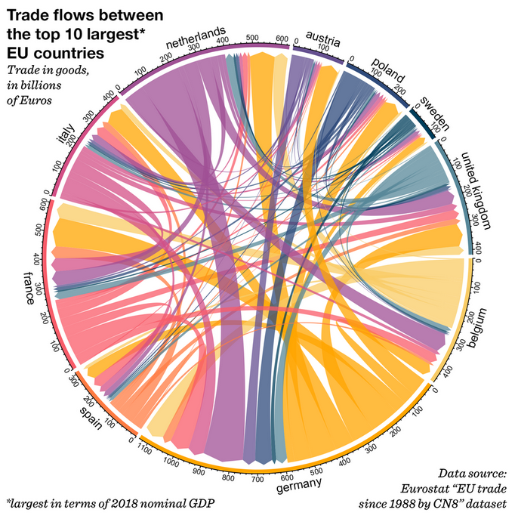
Example Continued
Notes:
Discussion time

Slide 11
Question 2 The History of World Trade and Why

Slide 12
Exercise 2
1) Discuss the possible reasons why the composition of world trade has changed substantially from the early 20th century to the early 21st century.
2) In relative terms, in the last century world trade in agricultural and primary-products (including raw materials) has declined. On the contrary, together with education, raw materials and agricultural products (e.g., beef) are the main Australian exports, see here. https://dfat.gov.au/trade/resources/trade-at-a-glance/Pages/top-goods-services.aspx
Should Australia worry? Should politicians do anything about it?
DEBATE 2
Notes:
Discussion time

Slide 13
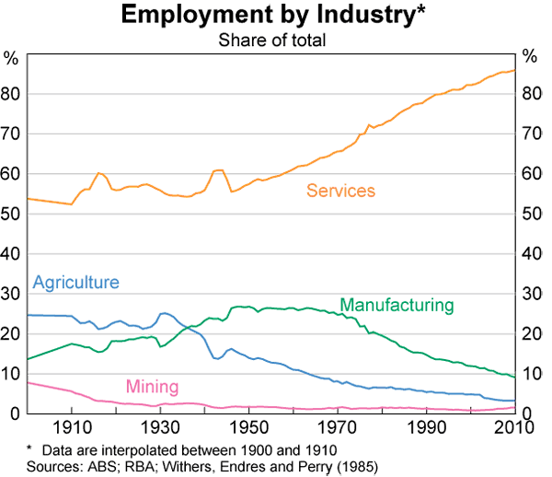
Exercise 2
Notes:
Discussion time

Slide 14
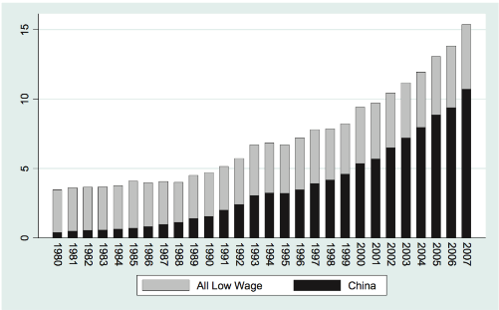
Trade Induced Technical Change
The Impact of Chinese Imports on Innovation, IT and Productivity
By Nicholas Bloom, Mirko Draka, and John van Reenen
Notes:
Discussion time

Slide 15
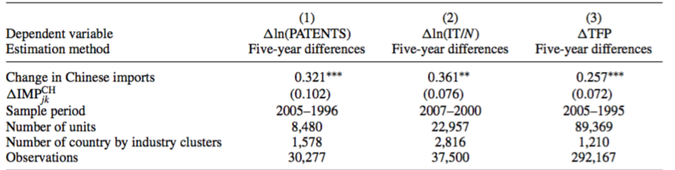
Trade Induced Technical Change Findings
Data: panel of 90000 firms between the 1990s and 200s, European Patent Office, IT data from Harte Hanks
Key Observations
Surviving firms create more patents, increases level of IT intensity, and productivity.
Increase R&D, management quality, and skill level, and reduces prices and profitability.
Import competition reduces employment and survival in low technology firms.
Firms with less patents of total factor productivity decreases in size, and exits quicker.
Notes:
Discussion time

Slide 16
Question 3 Using the Gravity Model

Slide 17
Exercise 3
Given the table below, compute the volume of trade between Australia and each of China, Japan and Mexico predicted by the gravity model, assuming that the constant A is 94.
By the look of it (i.e., without doing a rigorous statistical analysis), does the gravity model fit the data well?
 | GDP $trillion | Trade with AU A$m | Distance km to AU
China | 12.238 | 214,608 | 7,470
Japan | 4.872 | 85,762 | 6,821
Mexico | 1.151 | 3,741 | 14,345
Australia | 1.323
Notes:
Discussion time

Slide 18
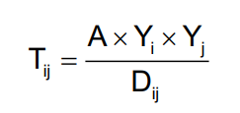
Exercise 3
T_{ij} is the value of trade between country i and country j
Y_{i} is the GDP of country i,
Y_{j} is the GDP of country j,
D_{ij} is the distance between country i and country j
A = 94
 | GDP $trillion | Distance km to AU | Trade with AU A$m | Gravity Model Answer
China | 12.238 | 7,470 | 214,608 | 203,740
Japan | 4.872 | 6,821 | 85,762 | 88,827
Mexico | 1.151 | 14,345 | 3,741 | 3,826
Australia | 1.323
Pretty Close. Though, what does the Gravity Model ignore? Think back to question 2.
Notes:
Discussion time

Slide 19
Exercise 3
T_{ij} is the value of trade between country i and country j
Y_{i} is the GDP of country i,
Y_{j} is the GDP of country j,
D_{ij} is the distance between country i and country j
A = 94
 | GDP $trillion | Distance km to AU | Trade with AU A$m | Gravity Model Answer
China | 12.238 | 7,470 | 214,608 | 203,740
Japan | 4.872 | 6,821 | 85,762 | 88,827
Mexico | 1.151 | 14,345 | 3,741 | 3,826
Australia | 1.323
Pretty Close. Though, what does the Gravity Model ignore? Think back to question 2.
Notes:
Discussion time

